Slide 1

IMDB movie review sentiment classification using LSTM
Notes:
To change the image on this slide, select the picture and delete it. Then click the Pictures icon in the placeholder to insert your own image.

Slide 2
Student Name Student ID Neeraj Kumar Barigela 700760341 Srinivas Musinuri 700758813 Aparna Surya 700760600

Slide 3
Responsibilities and Contribution
Srinivas Musinuri | Neeraj Kumar Barigela | Aparna Surya
Creating project flow chart ,work allocation and defining the goals | Creating project flow chart ,work allocation and defining the goals | Creating project flow chart ,work allocation and defining the goals
Collecting the literature related to the modules | Data Preprocessing , Text Analysis | Data Preprocessing
LSTM model Implementation | LSTM model Implementation | LSTM model Implementation
Conducting performance evaluation | Visualizing the results | Conducting performance evaluation
Project Proposal Documentation | Incremental Documentation | PPT Documentation
Final Incremental Documentation | PPT Documentation | Final Incremental Documentation

Slide 4
Motivation
In the past the success of movies was spread through word of mouth. With the evolution of the internet people are writing the opinions of their purchases, watching movies .Understanding the customer/audience pulse is crucial for any business or management. Reviews have a significant impact on business, as many customers look for reviews before making a purchase or adding movie to watch list . Natural Language Processing (NLP) and Artificial Intelligence (AI) are evolving to help with analyzing text data.

Slide 5
Objective
The current polarity classification solutions only consider words and do not take the context of the sentence. As a result, a sentence-level polarity classification model is needed, which can learn sequentially. The project proposes using an LSTM network for feature extraction, which has several components such as forget gates, input gates, cell states, and output gates.

Slide 6
Related Work
The paper is a collection of summaries of different research papers on the topic of movie success prediction using sentiment analysis and machine learning algorithms. It propose various approaches such as using Facebook posts, IMDb reviews, emotion analysis, and deep learning models to classify sentiments as positive or negative. The performance of different models such as SVM, logistic regression, CNN, LSTM, and Naive Bayes is evaluated on benchmark datasets. The papers highlight the advantages of deep learning models over machine learning models for text analysis tasks. These predictive analytics methods can be applied to various industries to predict the future perspective of items and products, particularly in the entertainment industry to predict the success or failure of movies.

Slide 7
Problem Statement
The Challenge in achieving high levels of accuracy in sentiment analysis is due to the inherent subjectivity of language.
The classification of emotions using sentiment analysis approaches produces unsatisfactory results.
The issue with the current methods is that it actually involves determining the sentence's tone and vocabulary, both of which can be accomplished by neural networks

Slide 8
Proposed Solution
The solution is to classify each review from IMDB website as either positive or negative. This classification will be based on the sentiment expressed in the review. The objective is to train a Long Short-Term Memory (LSTM) model to accurately classify the reviews as positive or negative. Once the model is trained, it will be used to predict the sentiment of reviews in a test dataset. The accuracy of the model will be evaluated based on its ability to correctly classify the sentiment of the reviews.

Slide 9
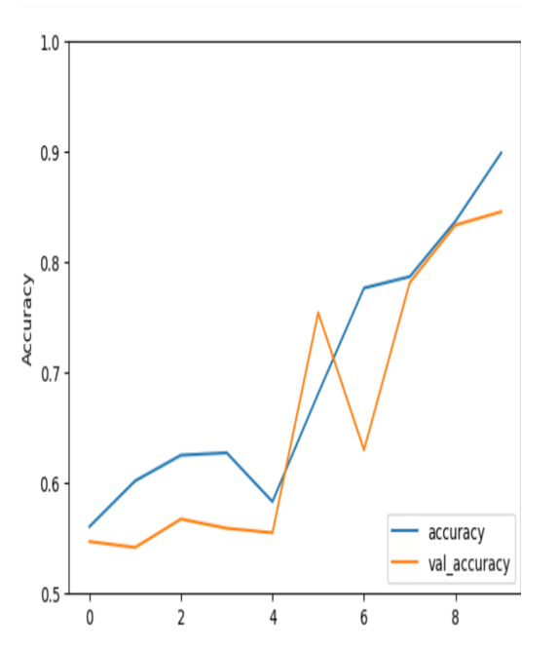
Result
The first layers is the embedding layer, In this layer we define the total number of words, embedding dimensions and maximum length of the input.
In the second layer we have added the Dropout layer with the dropout value 0.2
Finally we have added the dropout layer with the value 0.2.

Slide 10
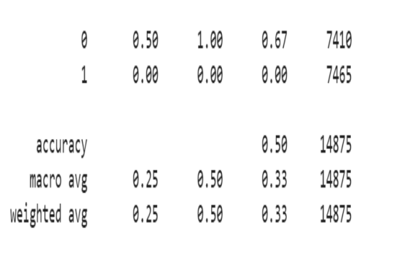
Result
Classification report displays the precision, recall and F1 score of the model.
The precision, recall and F1 score of the project are 0.5,1,0.67 for positive class and the negative class the accuracies are 0.

Slide 11
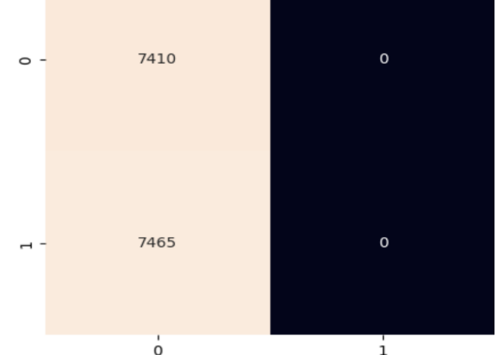
Result
Confusion matrix gives the quantity of the False positives and False negatives.
In the confusion matrix the diagonal values are true positives or true negatives. Other columns represents the false positives and false negatives in the predictions.

Slide 12
References
[1] Noor Latiffah Adam, Nor Hanani Rosli, and Shaharuddin Cik Soh. Sentiment analysis on movie review using na¨ıve bayes. In 2021 2nd International Conference on Artificial Intelligence and Data Sciences (AiDAS), pages 1–6, 2021.
[2] K. Amulya, S. B. Swathi, P. Kamakshi, and Y. Bhavani. Sentiment analysis on imdb movie reviews using machine learning and deep learning algorithms. In 2022 4th International Conference on Smart Systems and Inventive Technology (ICSSIT), pages 814–819, 2022.
[3] Egor Araslanov, Evgeniy Komotskiy, and Ebenezer Agbozo. Assessing the impact of text preprocessing in sentiment analysis of short social network messages in the russian language. In 2020 International Conference on Data Analytics for Business and Industry: Way Towards a Sustainable Economy (ICDABI), pages 1–4, 2020.
[4] Shreya Arora, Tushar Bhatia, Stuti Rastogi, and Vijay Kumar Sharma. Comparison of various classifiers for movie data. In 2021 3rd International Conference on Advances in Computing, Communication Control and Networking (ICAC3N), pages 138–140, 2021.

Slide 13
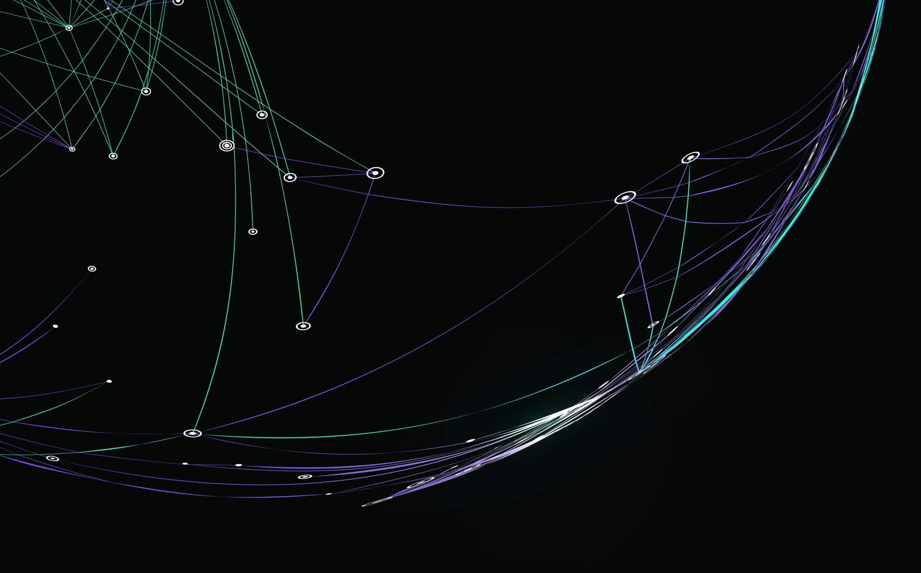
THANK YOU!!

